Slide 1
United International University (UIU) Final Exam Preparation for Fall 2024
Course: Data Structures & Algorithms – 1 (DSA 1)
Topic: Heap, Heap Sort, Heapify
Learn With Mahfuz

Slide 2
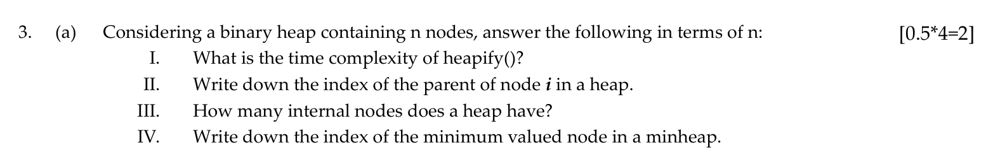
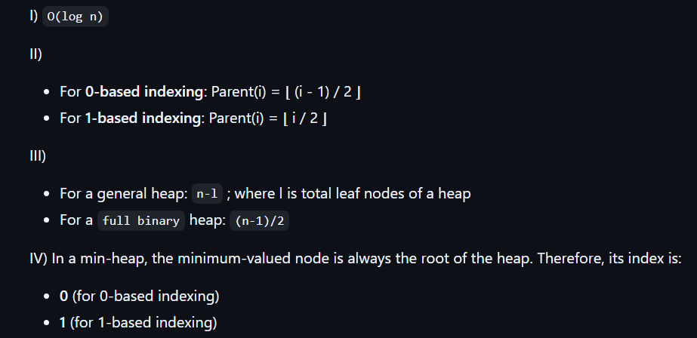

Heap, Heap Sort, Heapify
Spring - 24

Slide 3
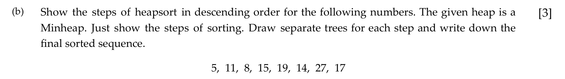
Heap, Heap Sort, Heapify
Spring - 24

Slide 4
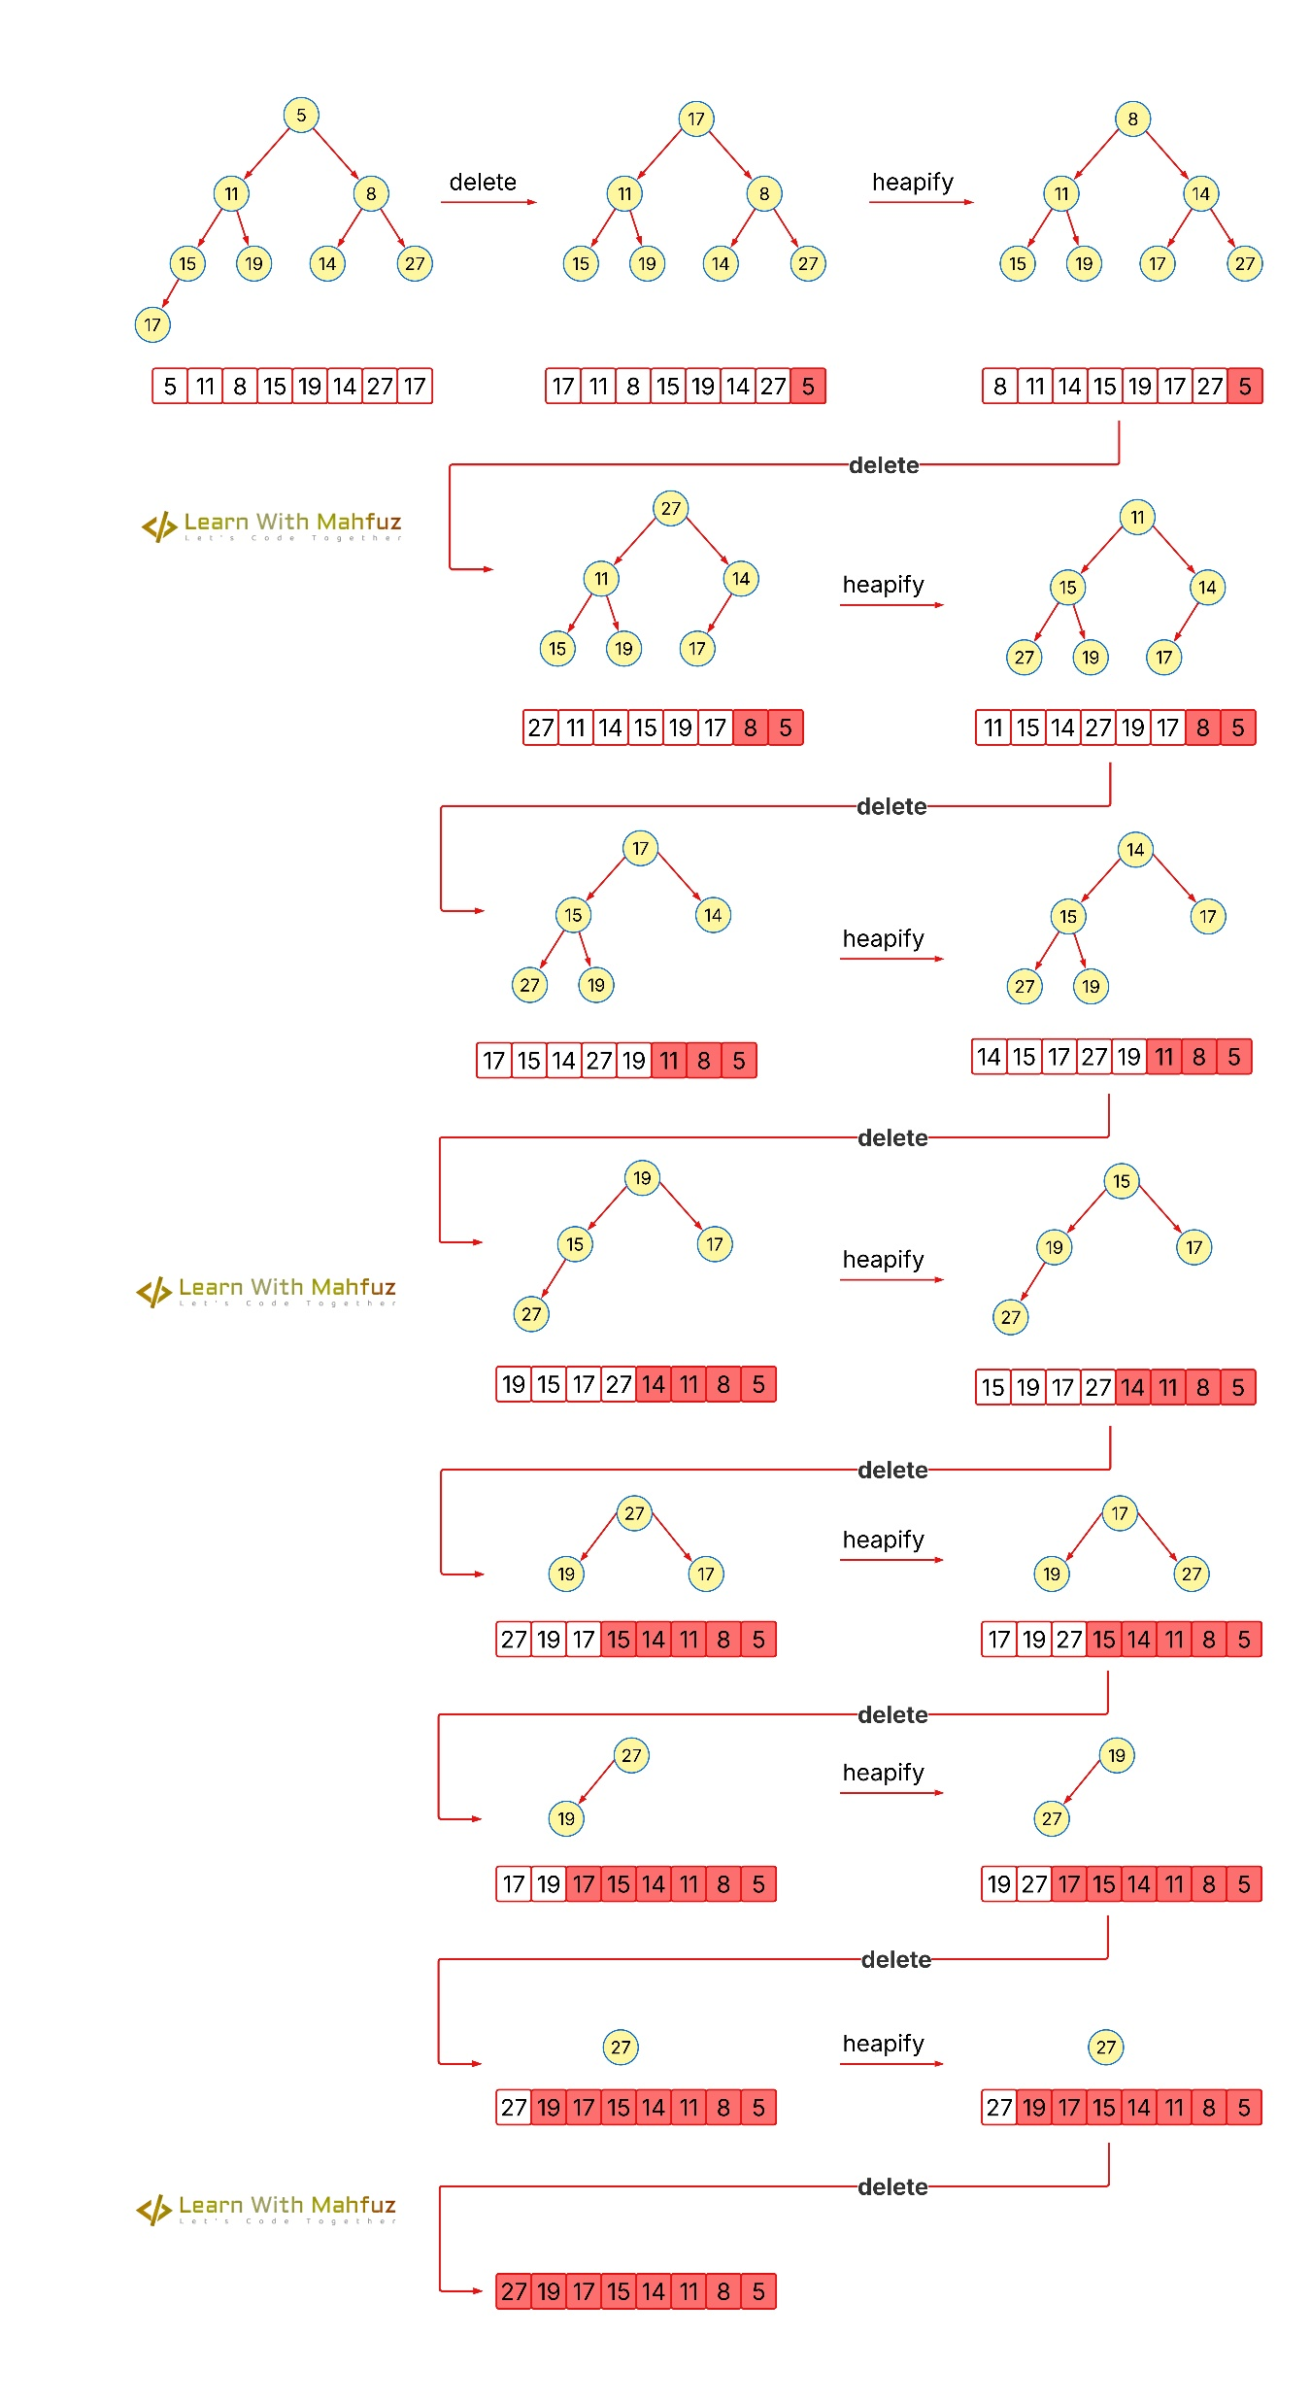
Spring - 24

Slide 5
Spring - 24

Slide 6
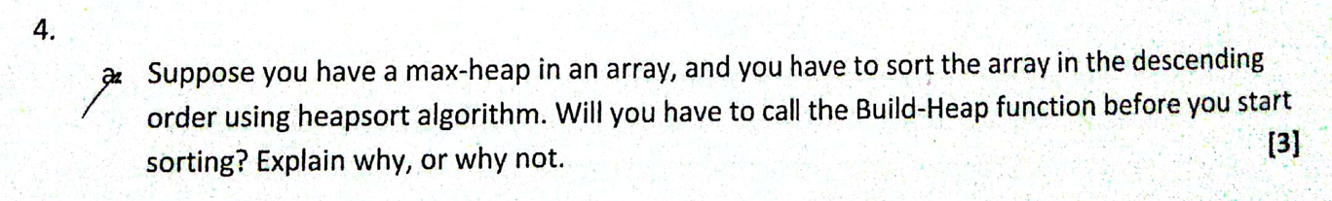
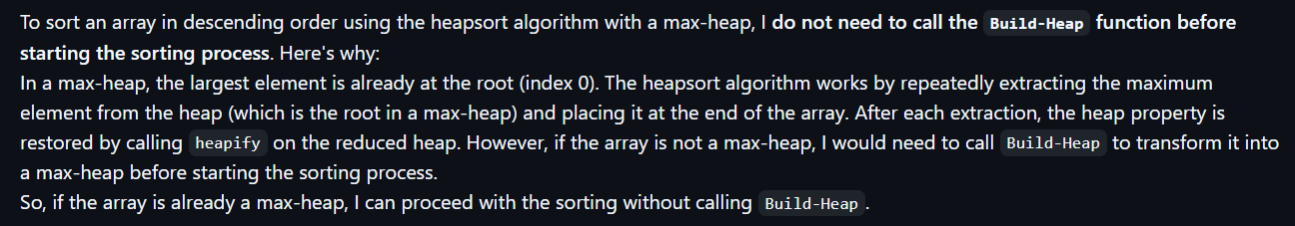
Heap, Heap Sort, Heapify
Summer - 24

Slide 7
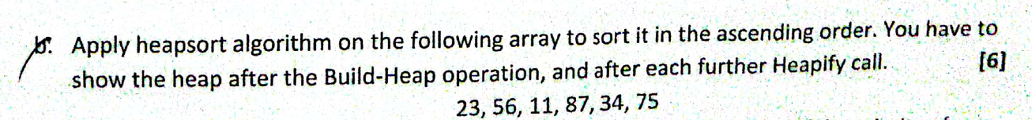
Heap, Heap Sort, Heapify
Summer - 24

Slide 8
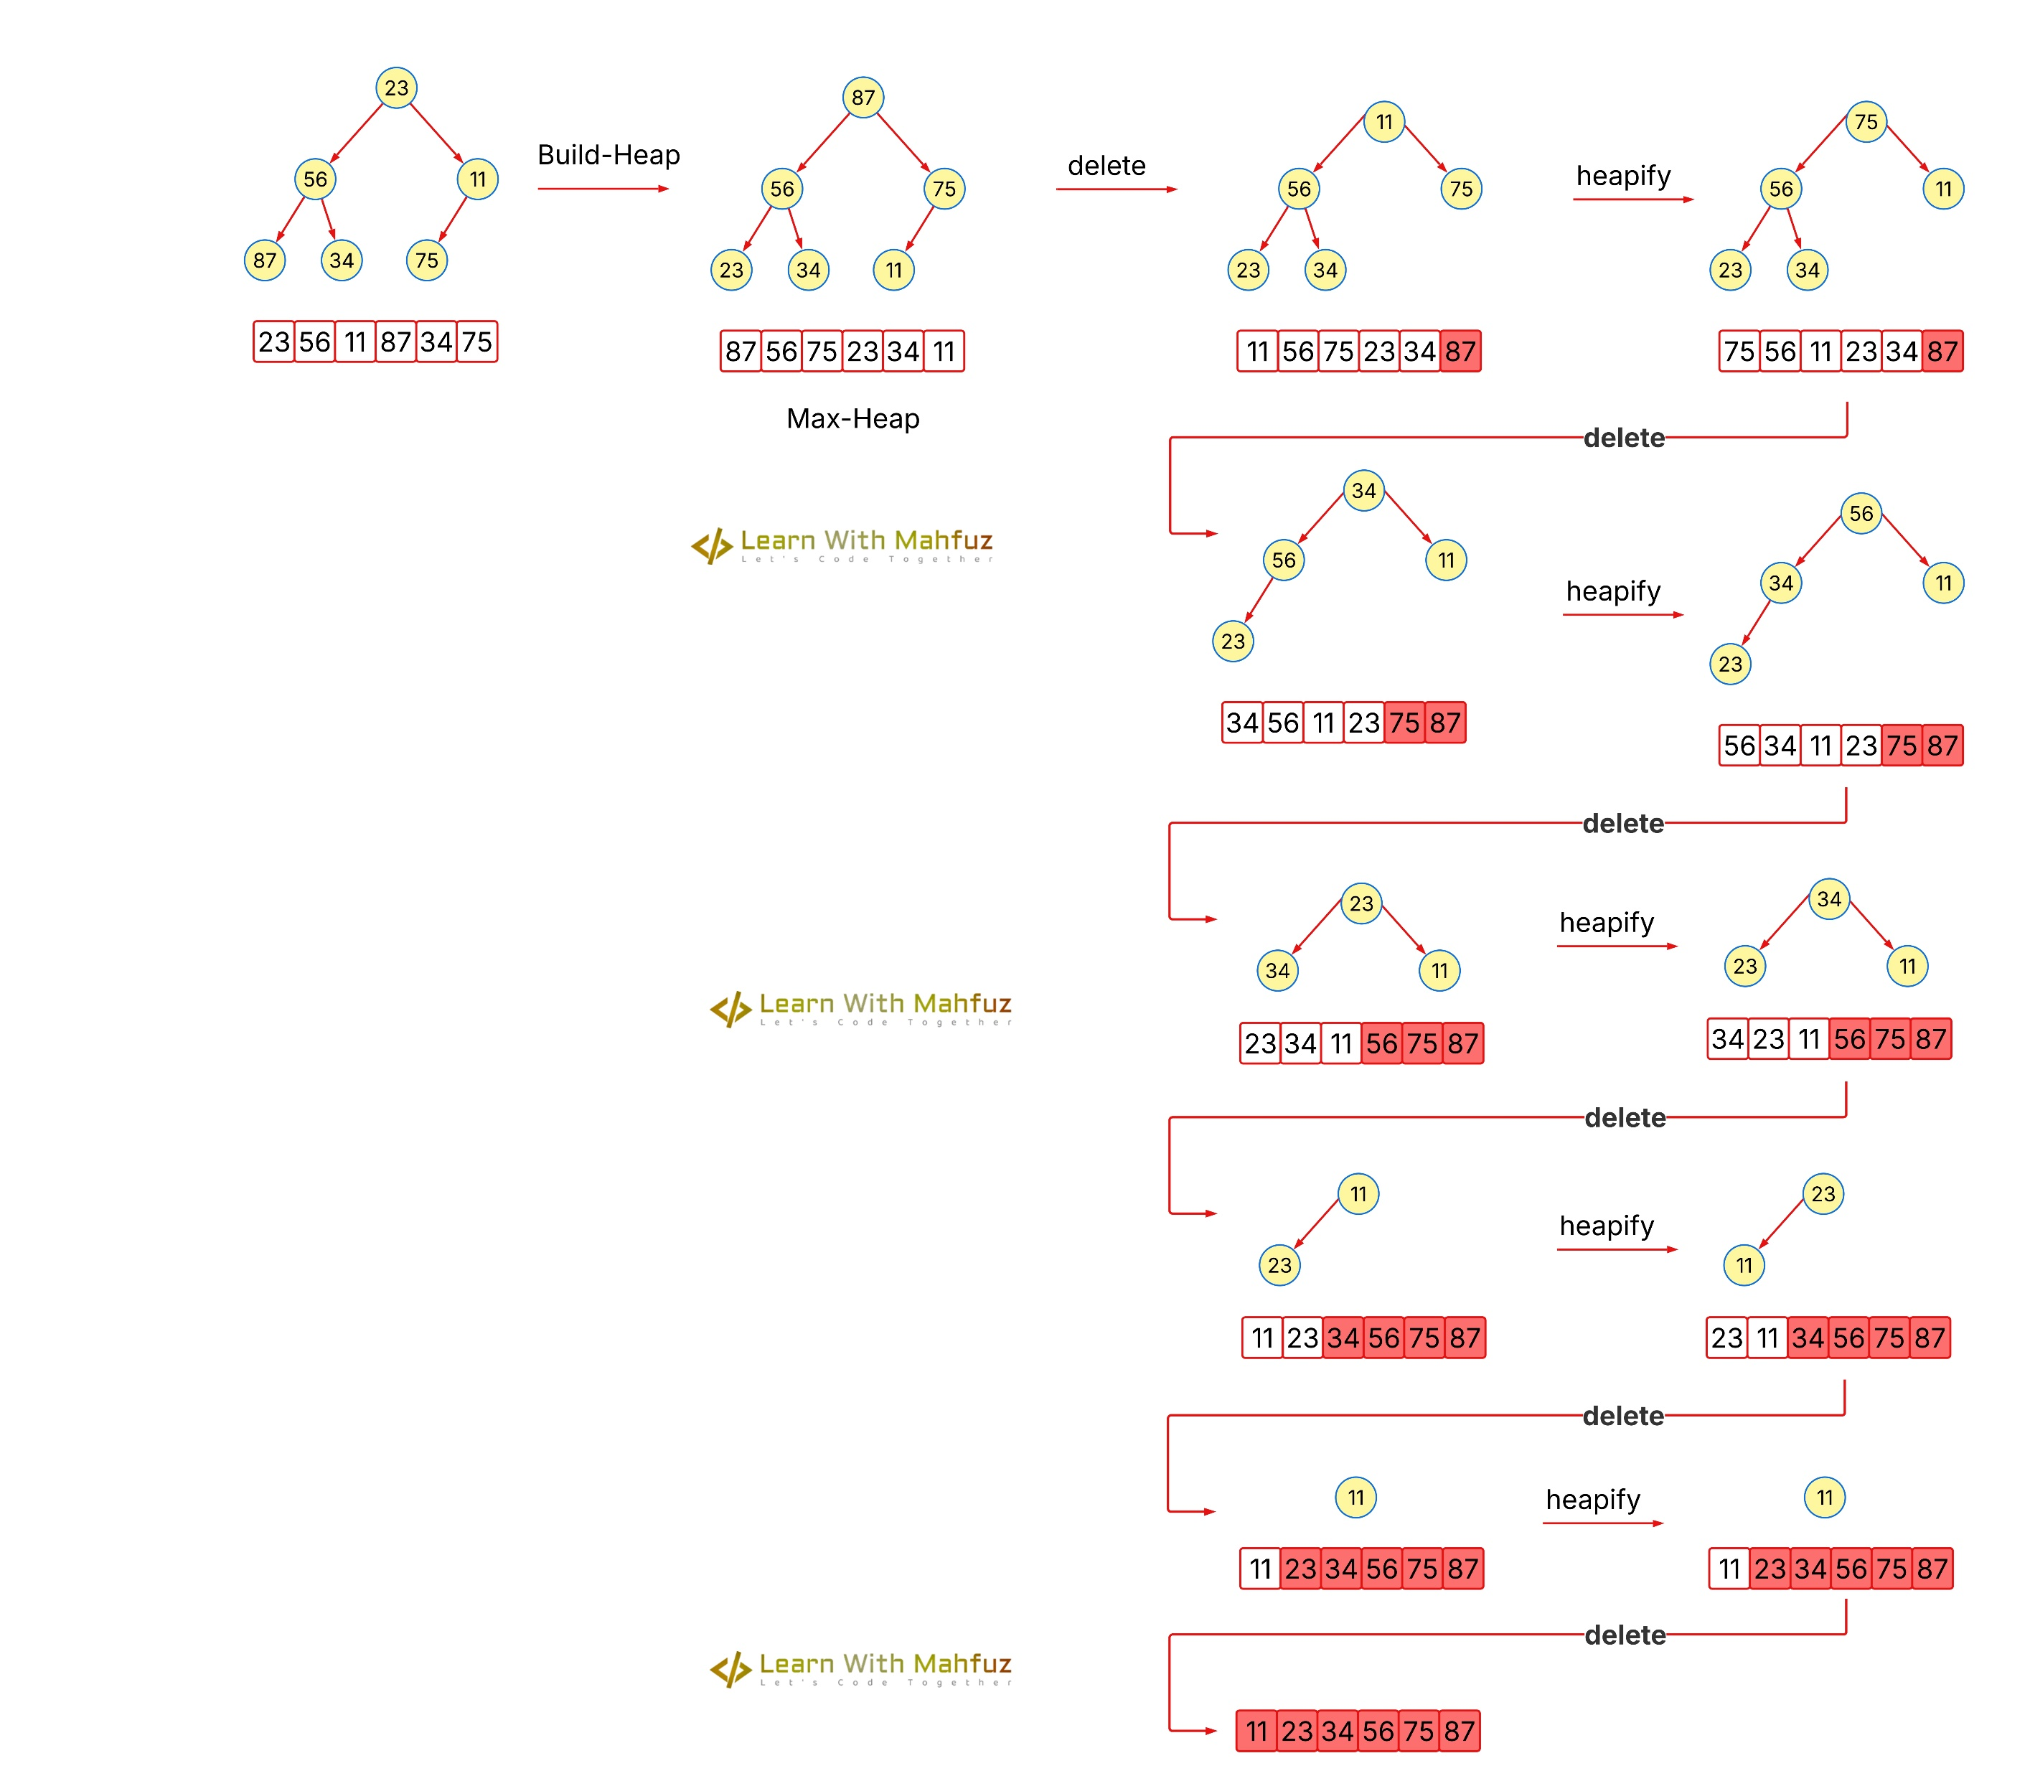
Summer - 24

Slide 9
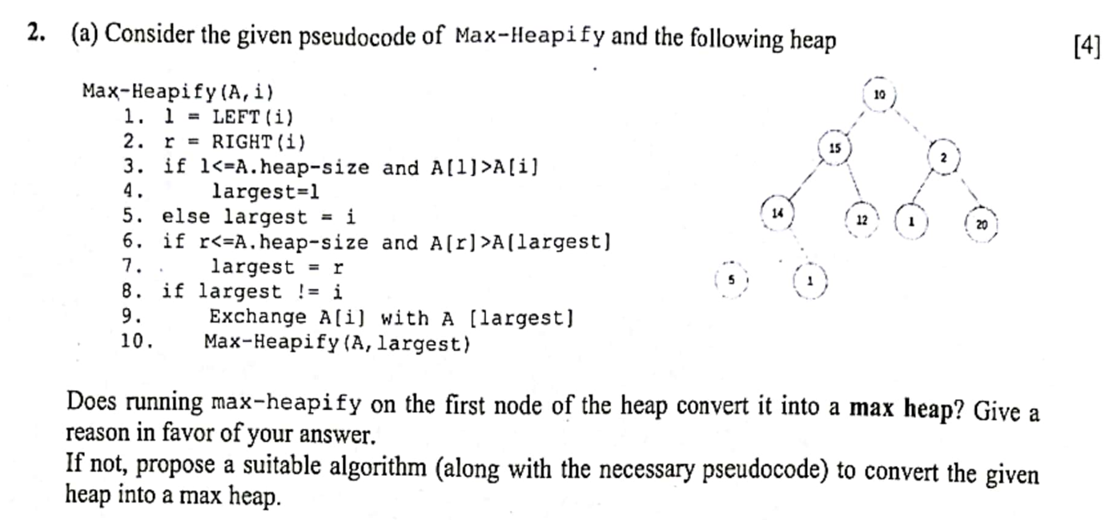
Heap, Heap Sort, Heapify
Summer - 23

Slide 10
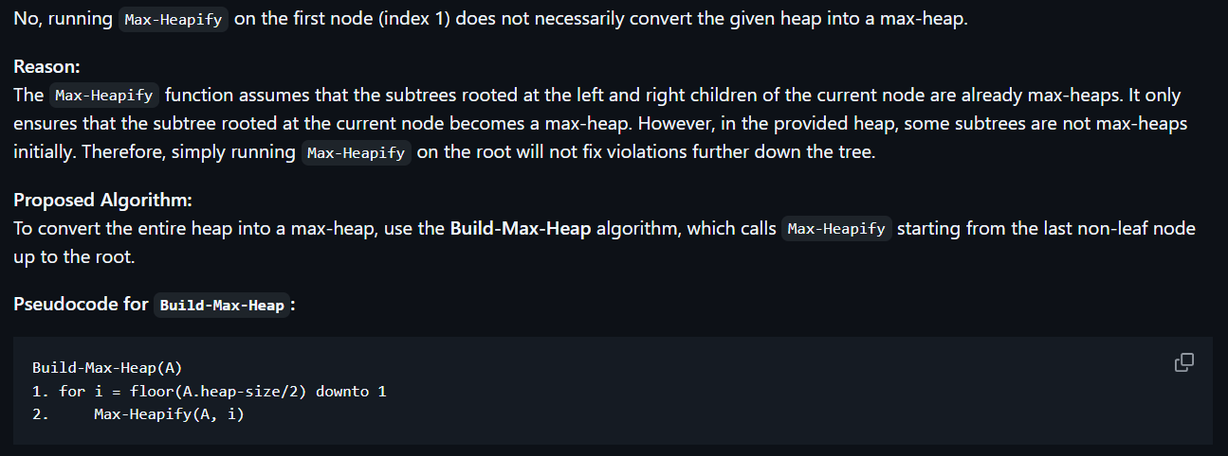
Heap, Heap Sort, Heapify
Summer - 23

Slide 11
Click here to go to the GitHub repository

Slide 12

Click here to see this video!

Slide 13
THANK YOU!

